Slide 1
Welcome to Our Presentation
Course Title: Java Programming
Course Code: CSE - 3318

Slide 2
We are presenting our project called
Mess & Hostel Managment System

Slide 3

Hello!
Showmik Debnath – 2012020075
Roni Acharjee – 2012020088
Department of Computer Science & Engineering
Leading University, Sylhet

Slide 4
Project Motivation
Students from remote places have to go far from their home to complete their study. In that case they need to stay in a hostel or mess.
A mess carried out by the manager to build they have to face some problem in financial calculation or managing.
So, we decided to build an application that would make easy the dynamic calculation of accounts of all our mess members easy.

Slide 5
Project Features
Firstly, the user should be complete their registration.
After Login,
In the User Section-
The user will see the Daily menu dish.
Also see his total meal, meal balance and cost.
Logout.
In Admin section-
Admin will see all the information of members.
Edit all member’s payment status, meal count, total cost.
And see individual meal details.
Also edit Daily Menu.
Admin can remove user.
Logout.

Slide 6
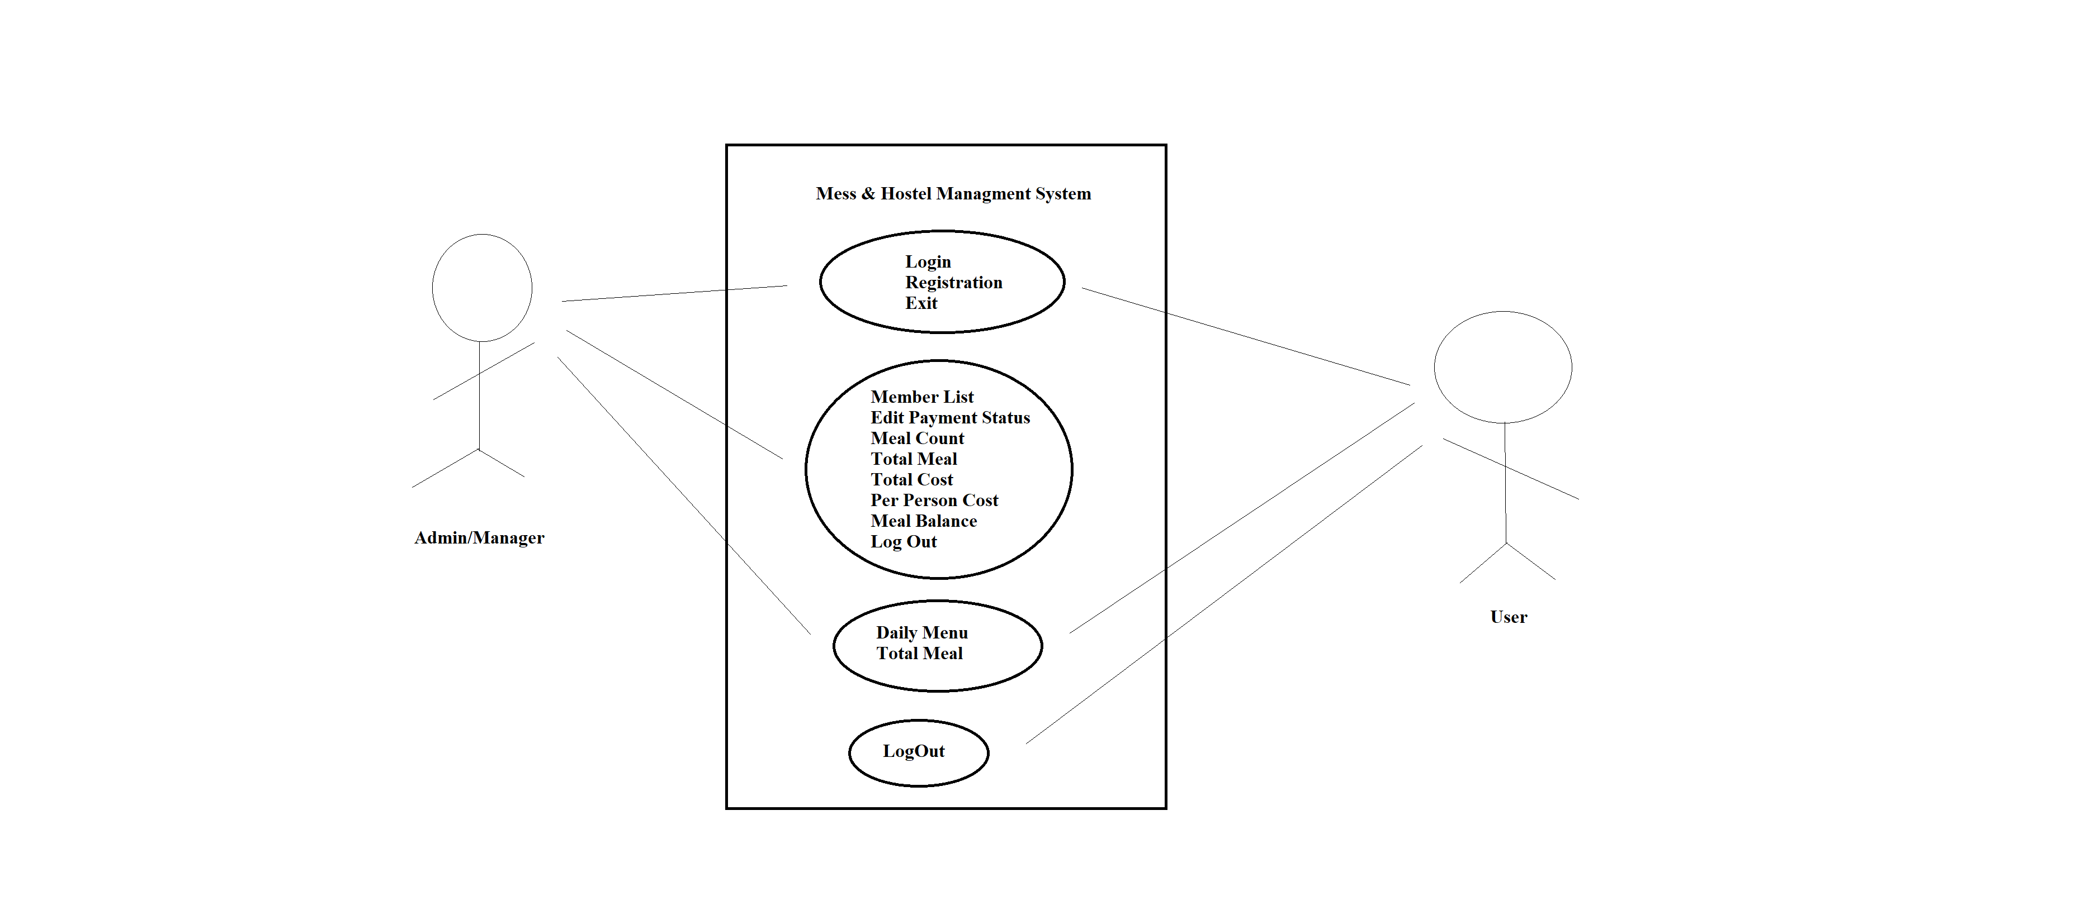
Project Use Case Diagram

Slide 7
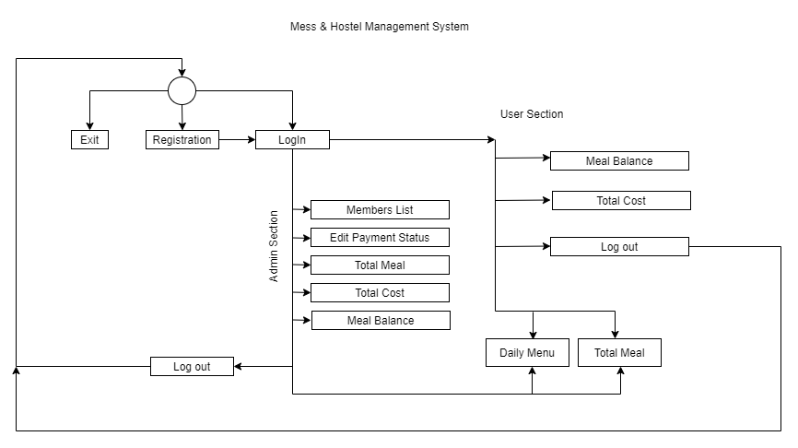
Project Activity Diagram

Slide 8
LIMITATIONS
User Can not see his personal meal
User can not edit anything in this application
Can not calculate per person meal
User and Admin can not change their password
User can not see their payment status

Slide 9
About this template
FUTURE WORK
In Future, This application will turn into a web application
People can use it by browser and can access it from anywhere
People can use it offline by native app version
Some more features will be added which have not been done before

Slide 10
Thanks!
Hope You Enjoyed It!

